Slide 1



Problem Theme Y4D
Team 21
25 August 2025
Abhimanyu Sharma - E&TC
Anshumala Pandit - Computer Science

Slide 2
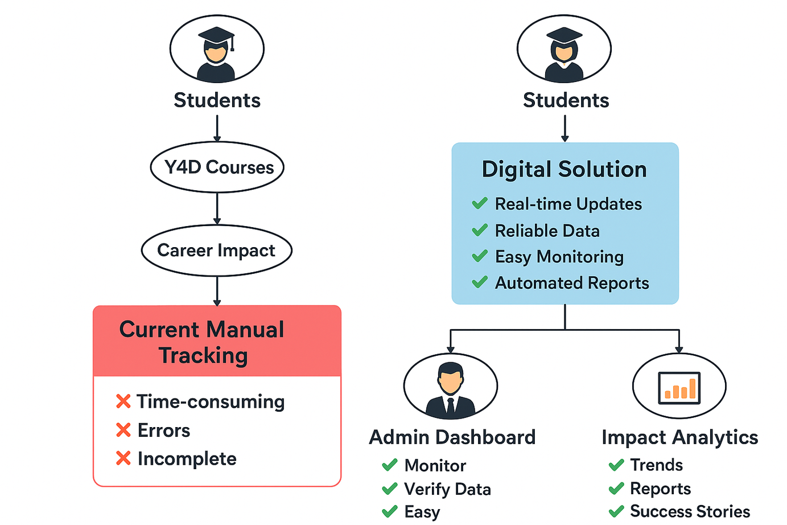
Problem Statement brief:
Y4D helps in upskilling young aspirants who want to start their careers in different domains by providing courses through which the students get job opportunities.
Current methods to track benficiaries are usually manual which are time consuming, inconsistent and more often than not yield incomplete data due to various different reasons.
Build a solution for outgoing students and Y4D administrators to create / update / monitor the impact Y4D has had on the students lives and in their individual and professional careers
2
25 August 2025

Slide 3
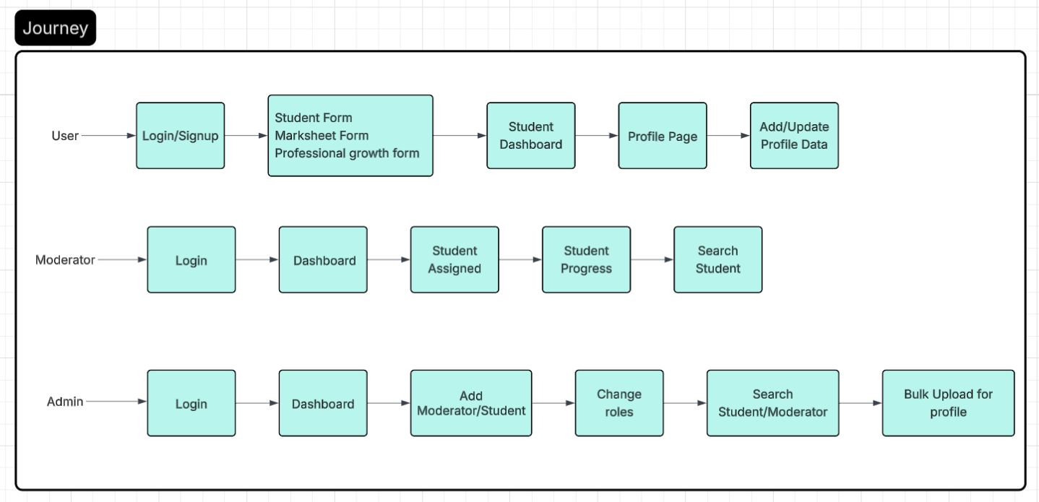
Solution Overview:
3
25 August 2025

Slide 4
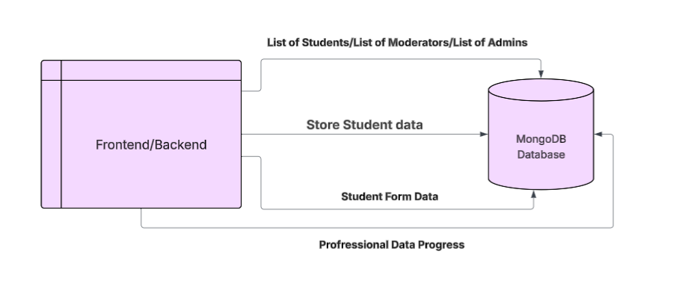
Solution Overview:
4
25 August 2025

Slide 5
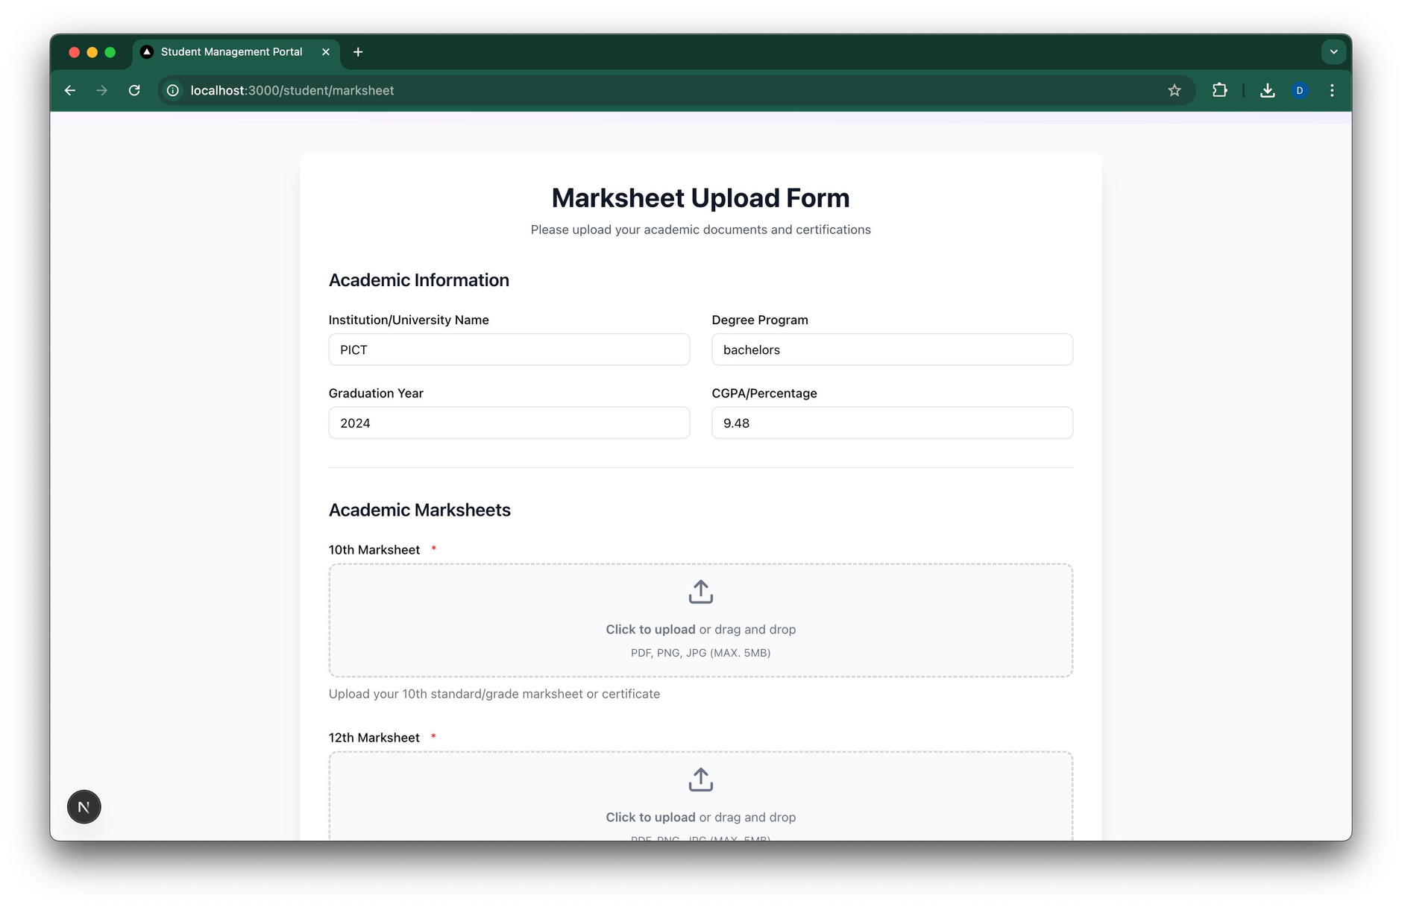
Demo/Prototype
URL : https://team-21-jet.vercel.app/
5
25 August 2025

Slide 6
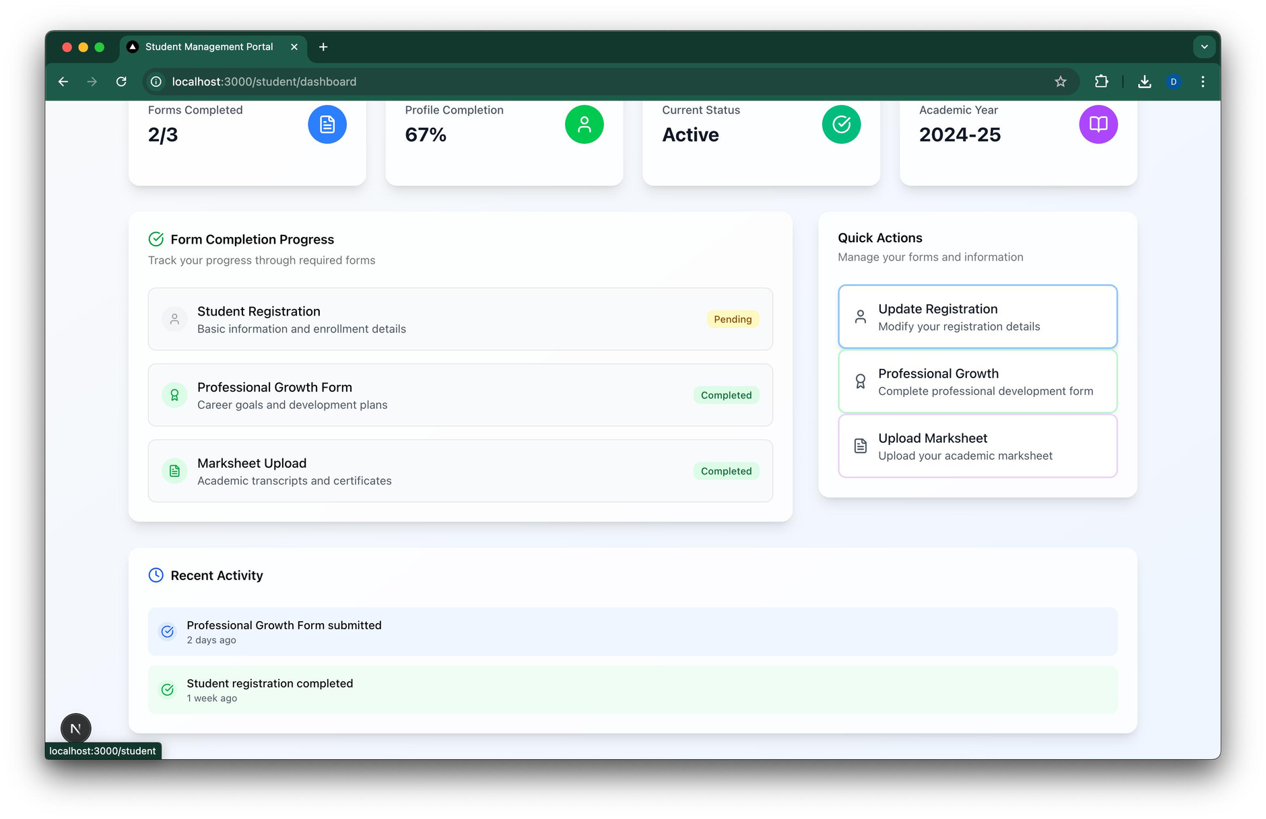
Demo/Prototype
6
25 August 2025

Slide 7
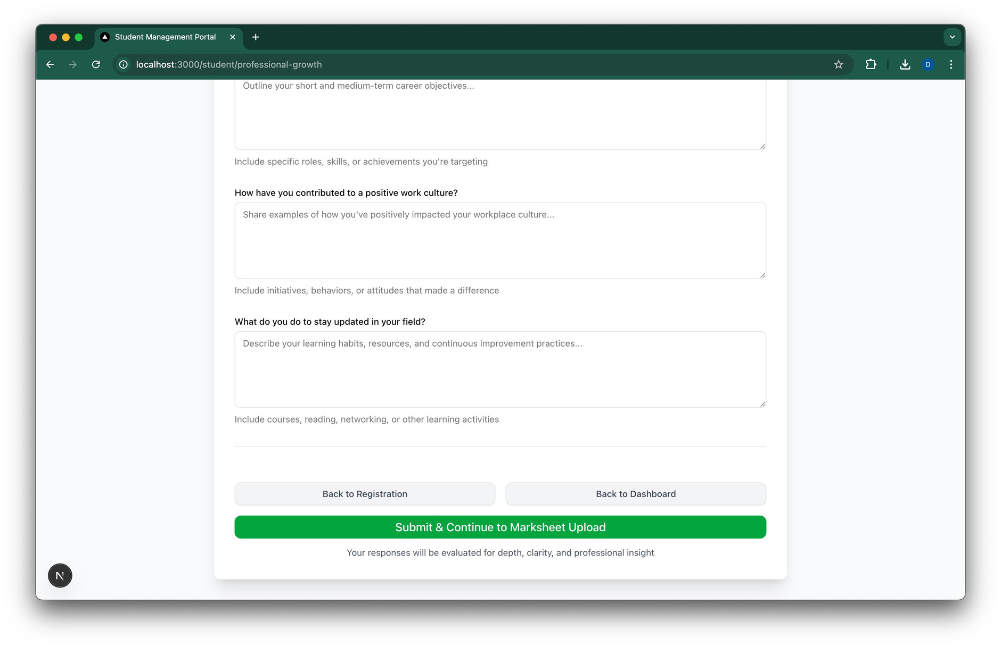
Demo/Prototype
7
25 August 2025

Slide 8
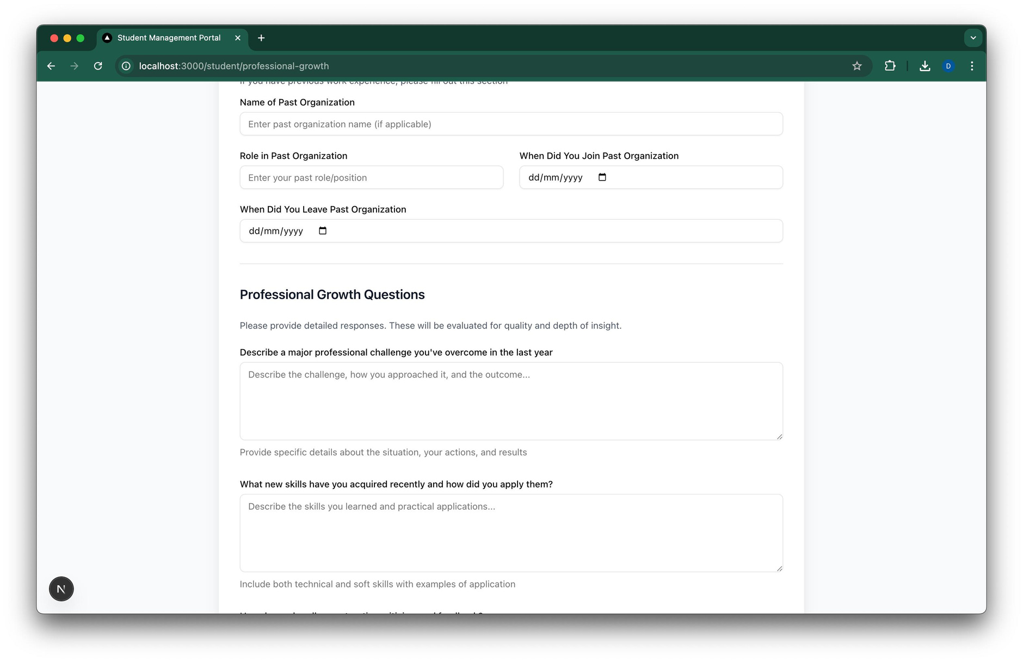
Demo/Prototype
8
25 August 2025

Slide 9
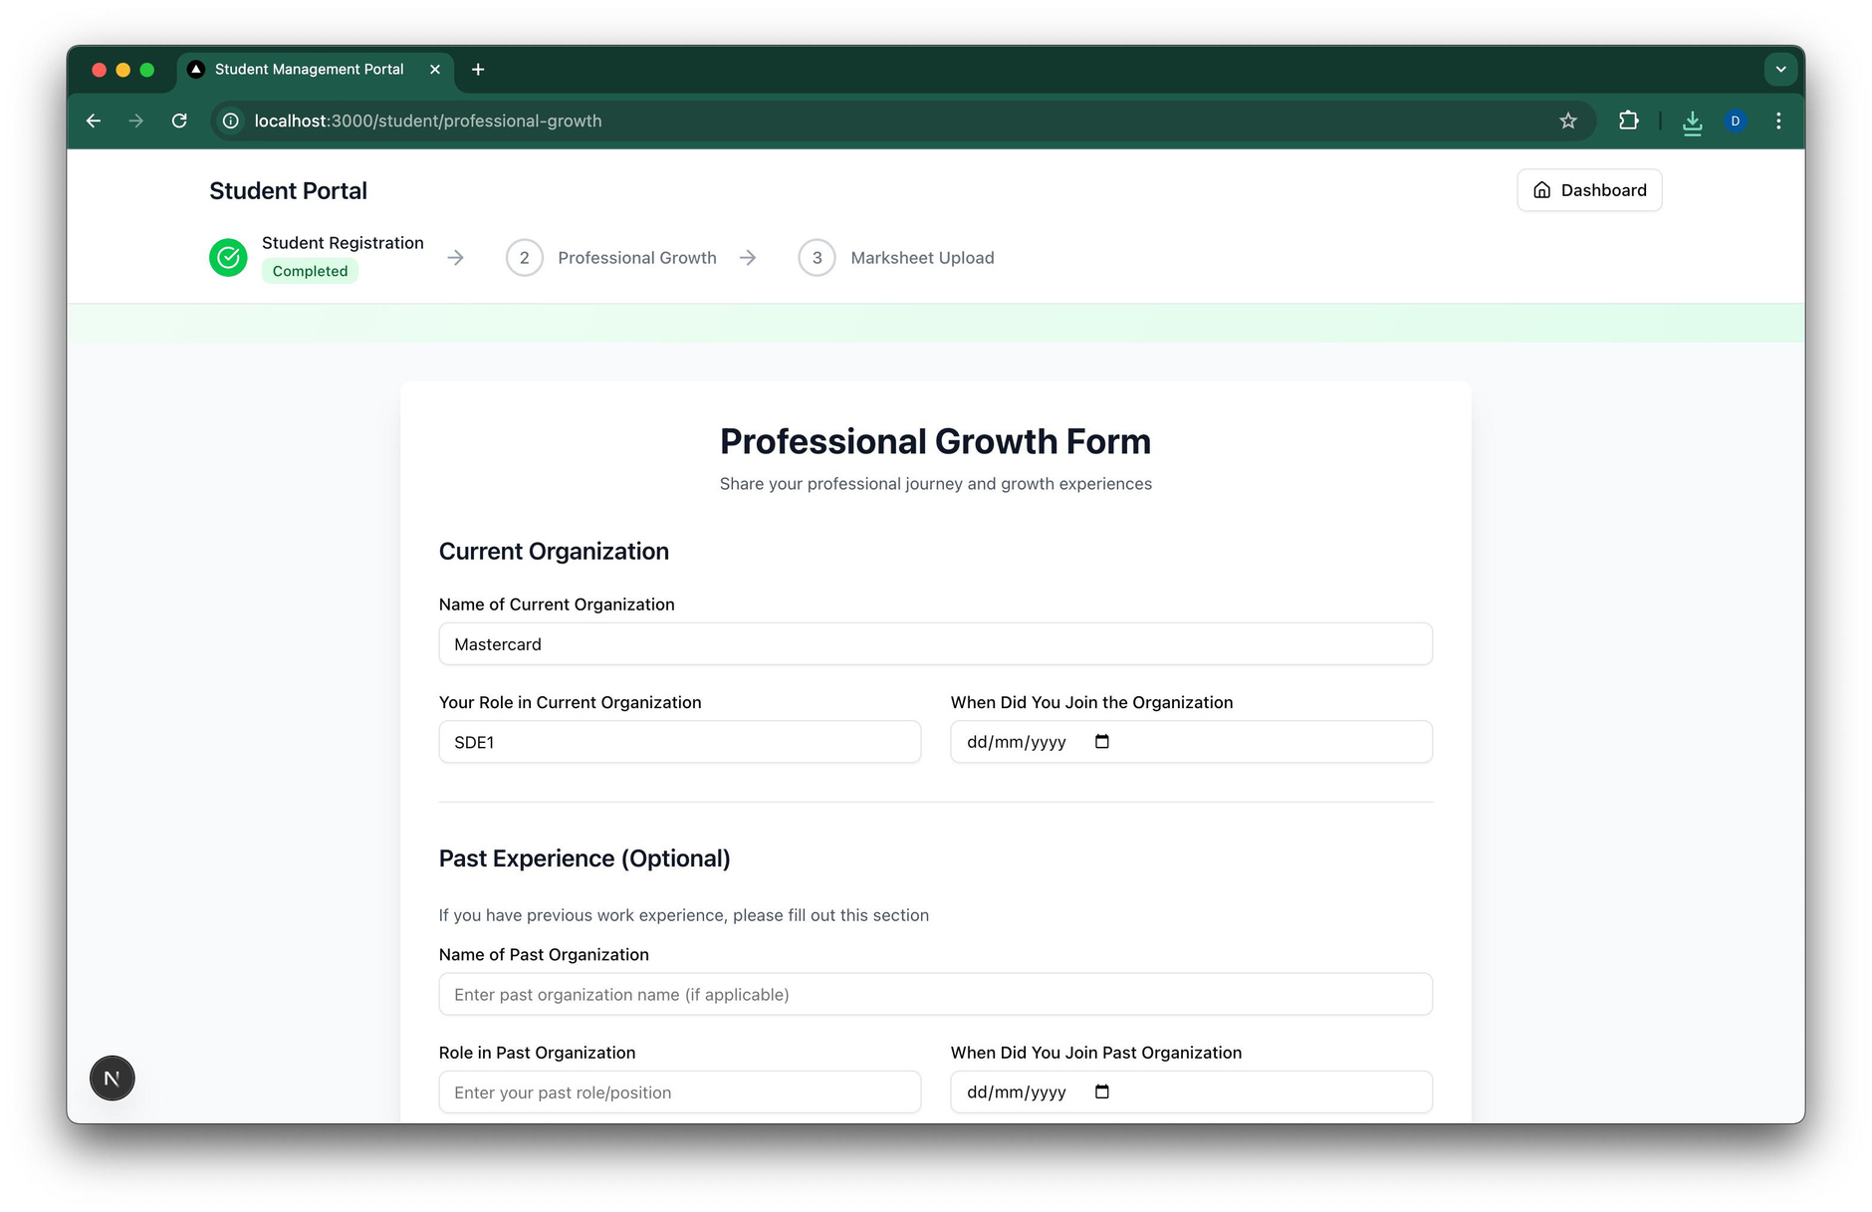
Demo/Prototype
9
25 August 2025

Slide 10
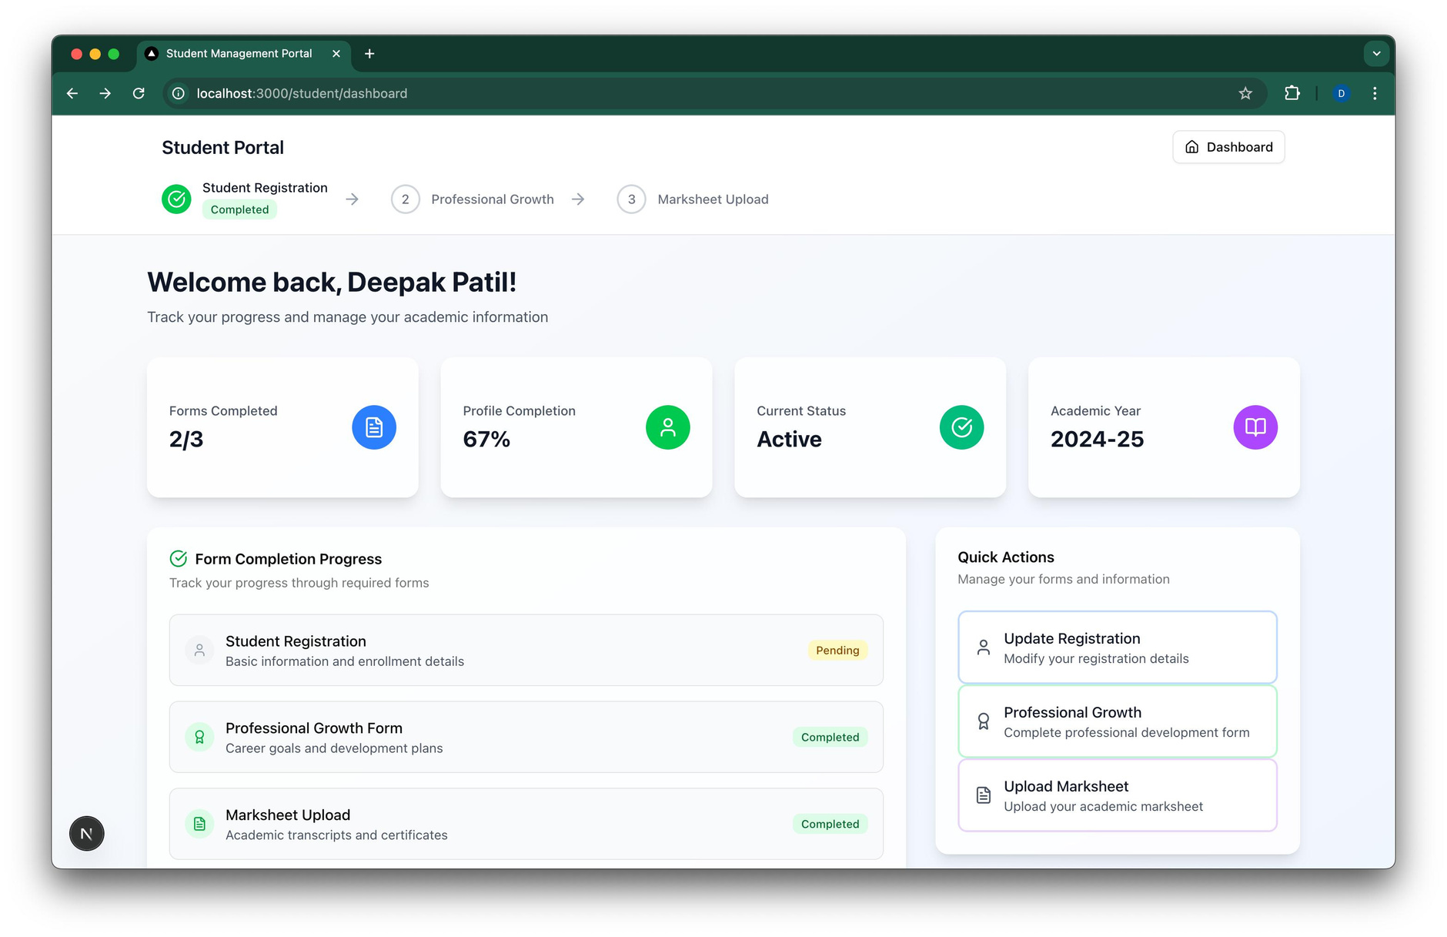
Demo/Prototype
10
25 August 2025

Slide 11
Demo/Prototype
11
25 August 2025

Slide 12
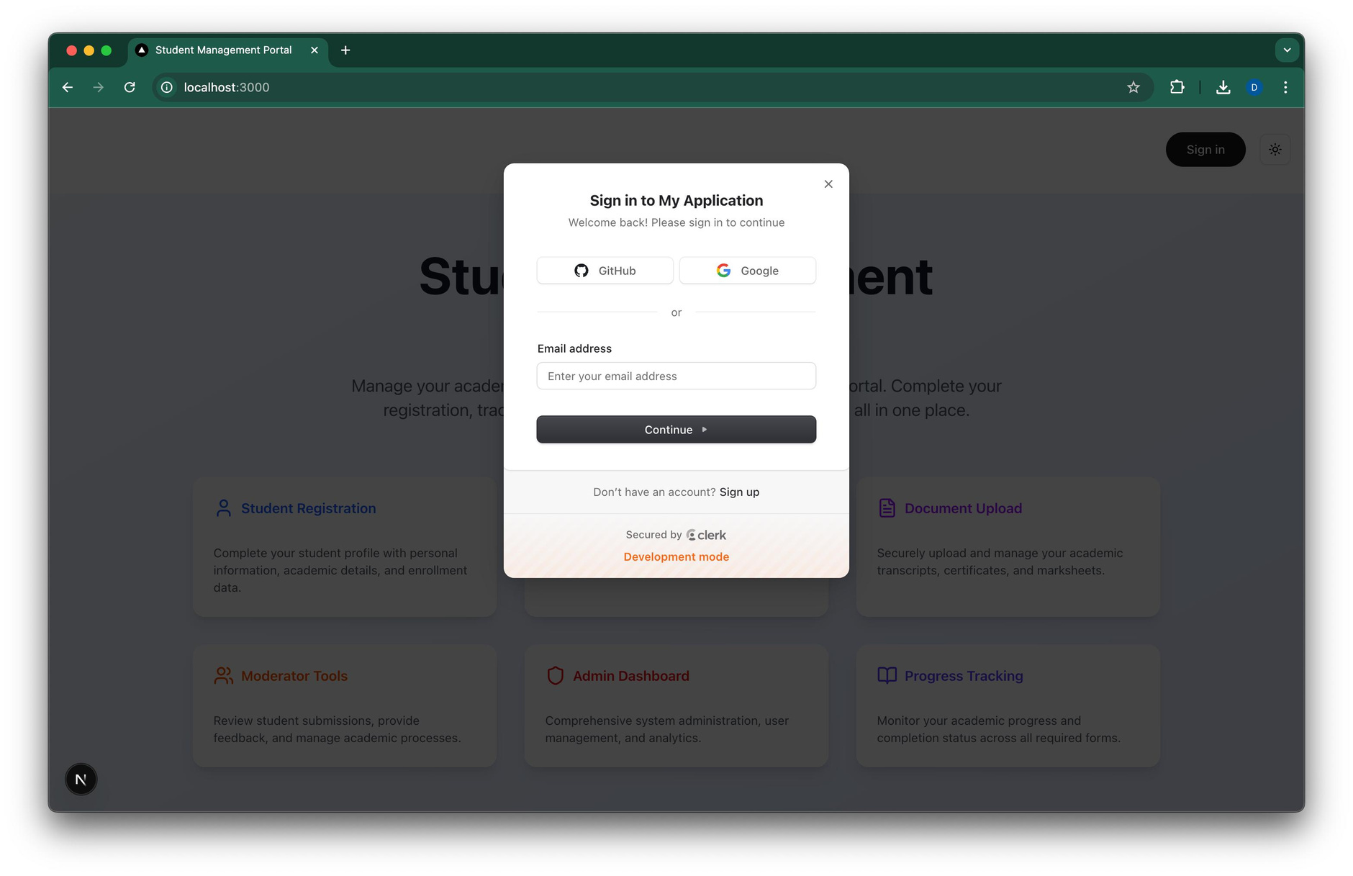
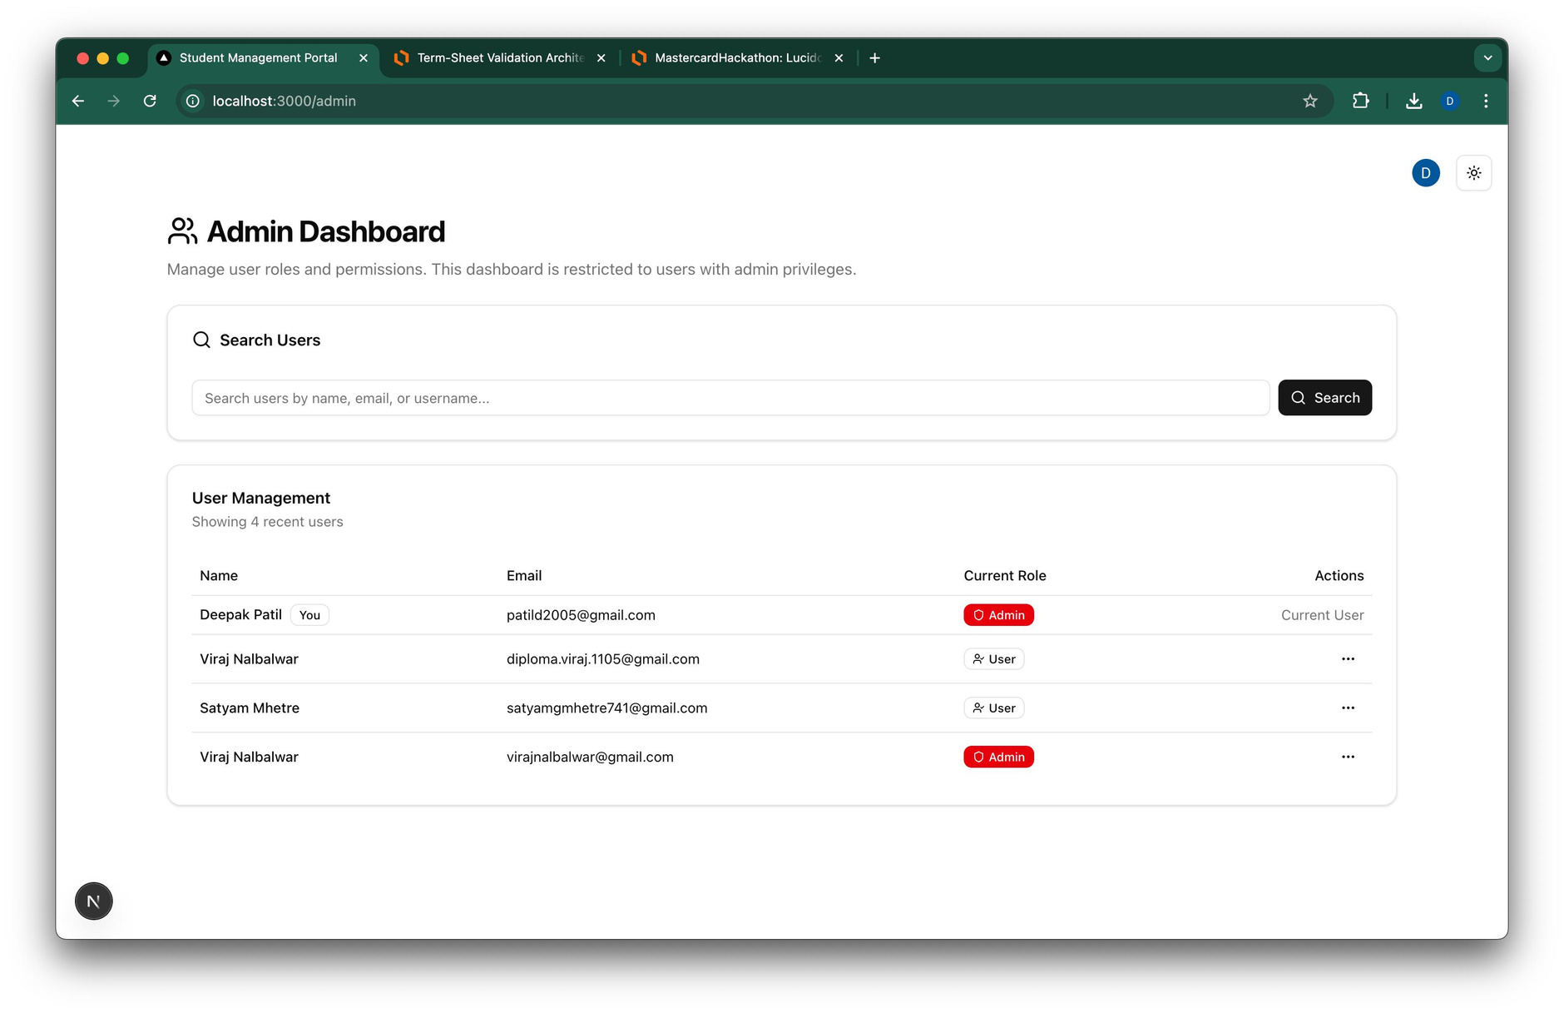
Demo/Prototype
12
25 August 2025

Slide 13
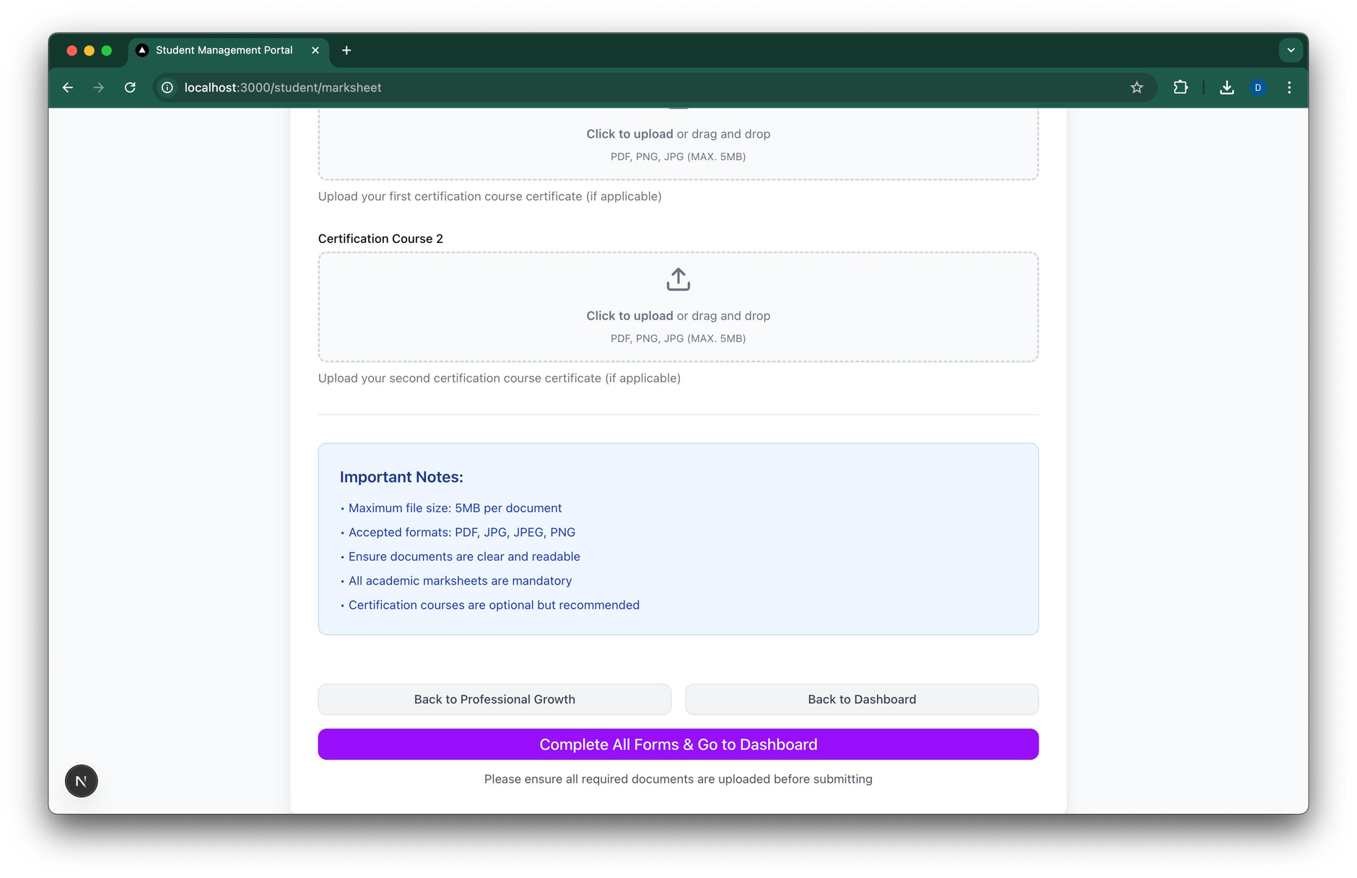
Demo/Prototype
13
25 August 2025

Slide 14
Demo/Prototype
14
25 August 2025

Slide 15
Technology Stack
Frontend-Nextjs
Backend-Python
Database-MongoDB
Framework- EmailJs, Shadcn
Authorization- Clerk
15
25 August 2025

Slide 16
Impact/Future scope
Integration with Job Portals: Connect with platforms like LinkedIn, Naukri, etc., for automatic career updates based on the skills entered by user and current job position.
Scalability: Y4D doesn’t need to limit itself to only the students who passed out a few year backs. They can connect with older alumni and connect with them to increase the community and also compare between old/new methods of their programs.
Role Guru : An AI agent can be added that is provided with all your past data like job history, courses, certifications and it gives the user courses to do in the future that will help the user to grow further professionaly
Performance Comparison: Can compare between various students of same department who have done different courses based on how different they are growing professionaly right now
Progression Tracker: With the help of LLM’s , can check professional progress of user, courses completed, rate user’s answers and give them a progression rating based on 0-5, and help the user with where they can do better or what they can learn to improve professionaly
16
25 August 2025

Slide 17
Q&A
7
August 20, 2024

